Slide 1

SMART CITY SOLUTION
Transport Civic Issue
Reporting & Resolution
System
Smart AI-Powered Urban Transport Monitoring
Team
Institution
Date
Tech Innovators
Engineering College
February 2026

Slide 2
The Challenge
Problem Statement
Critical Issues
Poor Road Conditions
Illegal Parking
Infrastructure Deterioration
Urban Encroachment
Potholes & Cracks: Damaged roads cause accidents and vehicle damage
Unauthorized Parking: Vehicles blocking roads and pedestrian pathways
Broken Signals: Malfunctioning traffic lights create dangerous intersections
Footpath Encroachment: Shops and vendors occupying public spaces
Missing Signage: Inadequate road signs lead to navigation confusion
No-Parking Zones: Violations in restricted areas causing bottlenecks
Annual Accidents
45,000+
Daily Violations
12,500+
Traffic Congestion
Broken Complaint System
Mobility Crisis
Process Failures
Peak Hour Jams: Excessive delays during rush hours
No Real-Time Tracking: Citizens left in the dark about complaint status
Unmonitored Bottlenecks: No real-time traffic flow management
Manual Resolution: Slow, paper-based processes cause delays
Construction Zones: Poorly managed work areas worsen congestion
No Feedback Loop: Resolved issues lack citizen verification
Avg. Delay
45 min
Resolution Time
30+ days

Slide 3
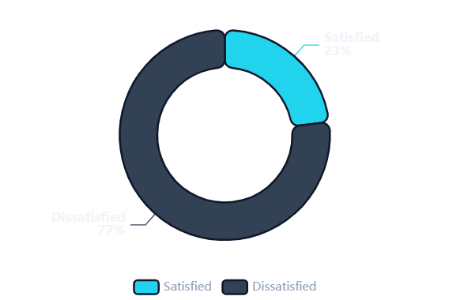
Current Limitations
Existing System Gaps
Critical shortcomings preventing effective urban transport management
No Centralized Platform
15+
Citizen Satisfaction Gap
Complaints scattered across departments. Citizens must navigate multiple channels—phone, email, in-person visits—creating confusion and inefficiency.
Departments
Delayed Authority Response
21
Manual routing causes weeks of delay. Issues remain unassigned as departments pass responsibility, leaving citizens frustrated.
Days Avg.
No Transparency
0%
Black-box resolution process. Citizens cannot track progress, view assigned departments, or understand expected timelines.
Visibility
Current Satisfaction
23%
Data Not Used for Planning
100%
Valuable complaint data sits unused. No analytics to identify hotspots, predict issues, or allocate resources proactively.
Wasted
Expected with Solution
85%

Slide 4
Our Approach
Unified Platform
Proposed Solution
End-to-End System
Real-Time Dashboard
GPS Tagging
Live tracking of all complaints with status updates, department assignments, and resolution timelines.
Precise Location
AI Engine
Mobile App
Smart Detection
iOS & Android
AI Verification
Computer vision validates issue authenticity, reducing false reports and prioritizing genuine problems.
Core Platform
Auto-Routing
Media Upload
Web Portal
Intelligent department assignment based on issue type, location, and workload distribution.
Photo & Video
Responsive Design
Smart Notifications
Push alerts keep citizens informed at every stage—from submission to resolution confirmation.

Slide 5
Platform Capabilities
Key Features
Powerful tools designed for seamless civic engagement
01
02
03
One-Tap Registration
Auto Department Routing
Priority Classification
Citizens can report issues instantly with a single tap. Pre-filled location data and quick-capture camera streamline the process to under 30 seconds.
AI-powered classification automatically forwards complaints to the correct department—roads, traffic police, or municipal corporation—eliminating manual sorting.
Issues automatically classified as High, Medium, or Low priority based on severity, location impact, and safety risk. Critical problems get immediate attention.
<30 sec submission
98% accuracy
HIGH
MED
LOW
04
05
06
Push Notifications
Public Issue Map
Analytics Dashboard
Real-time alerts keep citizens informed at every stage—submission confirmation, department assignment, work in progress, and resolution completion.
Interactive map displays all reported issues in the city. Citizens can view nearby problems, track resolution progress, and avoid problematic routes.
Comprehensive analytics for authorities—complaint trends, resolution times, hotspot identification, and department performance metrics.
Instant updates
Full transparency
Data-driven insights

Slide 6
Technology Stack
AI & Technology Integration
Powered by AI
Computer Vision
NLP Processing
AI Processing Pipeline
Image Analysis
Text Analysis
Advanced image recognition algorithms automatically detect and classify road defects from citizen-uploaded photos.
Natural Language Processing extracts key information from complaint descriptions, categorizing issues and determining urgency.
Pothole detection & sizing
Sentiment analysis
1
Data Ingestion
Image + Text + Location
Crack identification
Keyword extraction
Severity assessment
Auto-categorization
2
AI Analysis
CV + NLP Processing
Accuracy
94%
Processing
<2 sec
GIS Mapping
Predictive Analytics
3
Classification
Issue Type + Priority
Geospatial Intelligence
Risk Forecasting
Geographic Information System integration enables precise location tagging, spatial analysis, and hotspot visualization.
Machine learning models analyze historical data to predict high-risk zones and anticipate infrastructure failures before they occur.
4
Routing & Action
Department Assignment
GPS auto-capture
Traffic risk zones
Ward-level mapping
Maintenance forecasting
Route optimization
Resource allocation
Total Processing
System Uptime
±3m
87%
<5 sec
99.9%
Precision
Prediction

Slide 7
Technical Design
System Architecture
Scalable, secure, and intelligent infrastructure
Layered Architecture
Security
End-to-End Encryption
Presentation Layer
iOS
Android
Web
Mobile App (React Native) + Web Portal (React.js)
Role-Based Access
OAuth 2.0 + JWT
Application Layer
REST
JWT
Cloud Infrastructure
Node.js APIs + Authentication + Business Logic
AWS / Azure / GCP
Auto-Scaling
AI Engine Layer
CV
NLP
CDN Integration
TensorFlow + OpenCV + NLP Models
Performance
Data Layer
SQL
NoSQL
Response
Throughput
<200ms
10K/min
PostgreSQL + MongoDB + Redis Cache

Slide 8
End-to-End Process
User Flow / Working
Seamless journey from complaint to resolution
1
2
3
4
5
6
Capture Issue
Upload via App
AI Verification
Auto-Forward
Authority Action
User Update
Notification of resolution
User takes photo/video of road issue
Submit with auto GPS tagging
Computer vision validates issue
Routed to relevant department
Department resolves the issue
Submission Time
AI Processing
Routing Speed
User Alert
<30 sec
<5 sec
Instant
Real-time

Slide 9
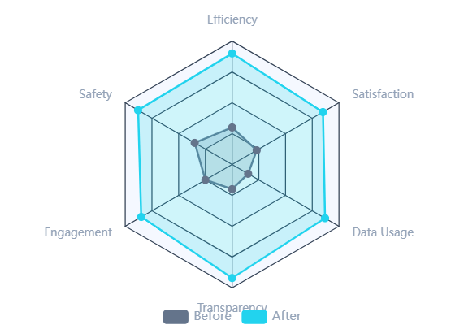
Value Proposition
Impact & Benefits
Measurable Results
Faster Resolution
Road Safety
Smart City Contribution
Automated routing and priority classification reduce resolution time from weeks to days, ensuring critical issues get immediate attention.
Proactive identification and rapid repair of hazardous conditions significantly reduce accidents and improve commuter safety.
Before
After
Accidents
Hazards Fixed
30 days
5 days
-45%
+180%
83% faster
Lives Saved
Citizen Engagement
Data-Driven Governance
Easy-to-use platform empowers citizens to participate in city improvement, fostering community involvement and civic responsibility.
Rich analytics enable evidence-based decision making, resource optimization, and proactive infrastructure planning.
Smart City Integration
Aligns with national smart city mission objectives
Active Users
Reports/Month
Data Points
Insights
50K+
25K+
1M+
Real-time
Sustainable Development
85% Satisfaction
Smart Planning
Reduces traffic emissions through better flow

Slide 10

Roadmap
Future Scope
Next Phase
IoT Sensor Integration
Drone Road Monitoring
Development Timeline
Phase 2 - Q3 2026
Phase 3 - Q1 2027
Deploy IoT sensors across the city for real-time monitoring of road conditions, traffic flow, and environmental factors without citizen reporting.
Autonomous drone fleets conduct regular aerial surveys to identify road defects, encroachments, and traffic violations from above.
Current Version
LIVE
Core platform deployed
IoT Integration
PLANNED
Vibration sensors for pothole detection
Automated aerial surveys
Q3 2026
Air quality monitoring
High-res imagery analysis
Drone Monitoring
PLANNED
Q1 2027
Noise level tracking
Traffic pattern monitoring
Traffic AI
Q3 2027
PLANNED
Traffic Prediction AI
Smart City Integration
Full Integration
VISION
Phase 4 - Q3 2027
Phase 5 - 2028
2028
Advanced ML models predict traffic congestion patterns, enabling proactive signal management and route recommendations for commuters.
Seamless integration with broader smart city infrastructure—utility management, public safety, emergency services, and urban planning.
Congestion forecasting
Unified city dashboard
Dynamic signal control
Cross-department sync
Ready to Transform
Route optimization
Centralized command center
Building smarter cities, one report at a time

